Slide 1
Technique tutorial – Structured Process Modeling
Structured Process Modeling
Systematic approach to process modeling
In order to increase process model quality
By reducing cognitive load

Slide 2
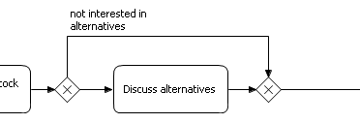
Technique tutorial – Structured Process Modeling
Process Model Block
collection of process paths that originate from the same split construct and that come together in the same join construct

Slide 3
Technique tutorial – Structured Process Modeling
Technique
Work block per block, one at a time
Finish modeling of block first before working on other parts of the model
Do not work on the rest of the model as long as the block is not finished

Slide 4
Technique tutorial – Structured Process Modeling
Steps
From the point you realize the process flow splits into multiple paths, finish all paths from the split construct until they join, before working on the rest of the model.
If you encounter a second split within one of the paths of an earlier split, you are creating nested process model blocks. In that case, first complete the inner process model block, then proceed with the outer block, and only then work on the rest of the model.
Combine steps 1 and 2 to construct the whole process model.
Whenever you come accross a new split, use rule 1.
Whenever one of a series of splitted paths splits again, use rule 2.

